Slide 1
AMAZON SALE

Slide 2
INTRODUCTION
Amazon Sales data refers to sales, high performing sellers and several other data points. There are millions of Amazon sellers around the world. Amazon sales data Analysis focuses on the process of analyzing consumer behavior, sales, and several other attributes in order to make improved, data-driven decisions. It is key to successfully sustaining their businesses and earning profits and for this purpose, they analyze different metrics like sales, Sales Quantity, Discount rate, Sales over years etc. By analyzing different metrics, you will be able to increase and improve your performance in terms of sales, Items to be sold and discount rates etc. Analysis of the sales data the main factor that contributes to sellers improving their business and increasing their revenue. They can better understand the market trends and customers’ buying behaviors and help them cater to what the customers really want. In the world of rising new technology and innovation, E-commerce industry is advancing with the role of Data Analytics. Data analysis can help them to understand their business in a quiet different manner and helps to improve the quality of the service by identifying the weak areas of the business. This study demonstrates the how different analysis help to make better business decisions and help analyze customer trends and satisfaction, which can lead to new and better products and services. Different analysis performed to get the key insights from this data based on which business decisions will be taken

Slide 3
PROBLEM
Sales management has gained importance to meet increasing competition and the need for improved methods of distribution to reduce cost and to increase profits. Sales management today is the most important function in a commercial and business enterprise. The objective of the project is to Analyze Amazon Sales data to get a substantial data which will help in bringing changes in a business in the future. It will help to reveals flaws in the business model or in the way that one is going about conducting business. Sellers will be able to clearly see where they’re losing money, what the problem is, and reduce their losses accordingly. It facilitates coming up with strategic solutions to problems. This project aims to provide visual understanding of the data using Microsoft Power Bi.

Slide 4
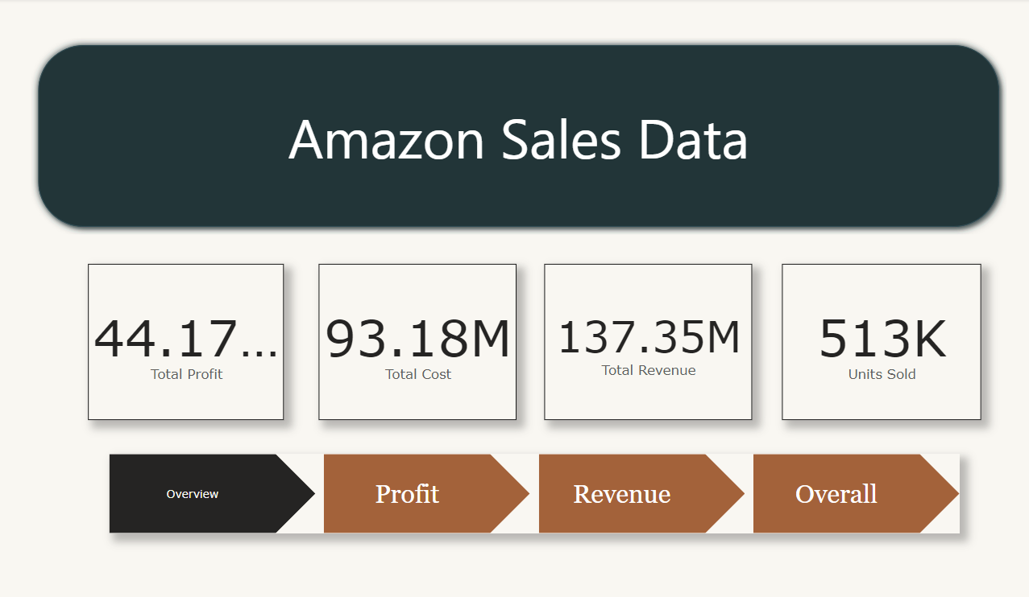
This is an overview of Amazon sales data, showing total profit, total cost, total revenue, and units sold.
The revenue is 137.35 million, with a profit of 44.17 million.
This data could be from a specific time period, product category, or geographic region.

Slide 5
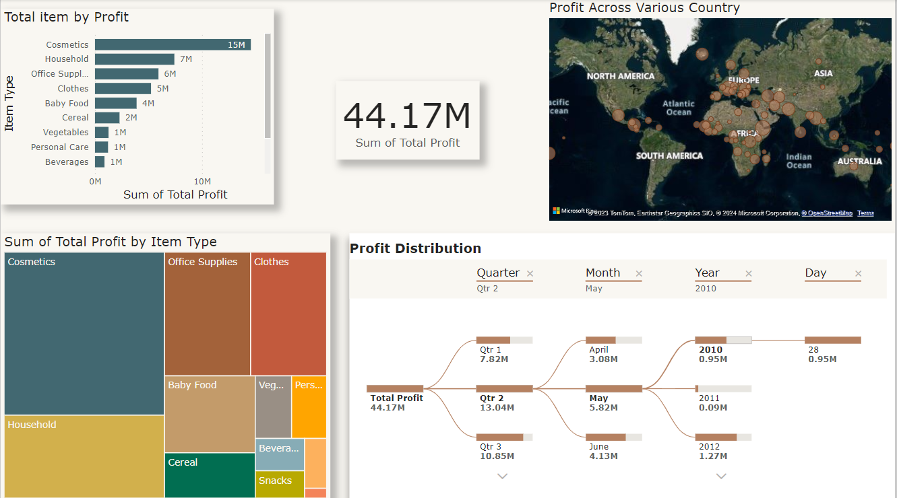
Profitability by country: North America is the most profitable region, followed by Europe and Asia. Africa and South America are the least profitable.
Profitability by item type: Cosmetics is the most profitable item type, followed by household goods and office supplies. Baby food, vegetables, and beverages are the least profitable.
Profitability over time: Profit has been increasing steadily over time. The largest increase was in Qtr 2, 2011.
Trends: There appears to be a seasonal trend in profitability, with profits being higher in the summer months.

Slide 6
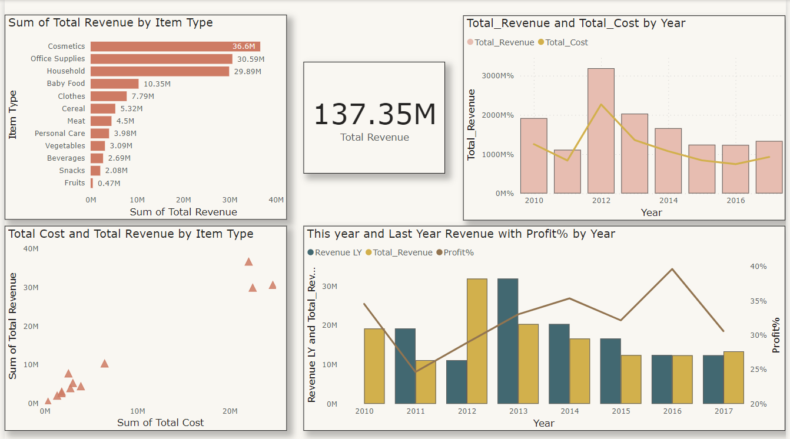
Revenue growth: The total revenue of the company has been increasing steadily over time. From 2010 to 2016, the total revenue increased from 10M to 3000M, which is a 300 times increase.
Profitability: The company's profit margin has also been increasing over time. In 2010, the profit margin was 20%, and in 2016, it was 40%. This suggests that the company is becoming more efficient at generating profits.
Product mix: The mix of products that the company sells has also changed over time. In 2010, the majority of the company's revenue came from cosmetics and office supplies. However, by 2016, the majority of the company's revenue came from clothes and meat. This suggests that the company is shifting its focus to more profitable products.

Slide 7
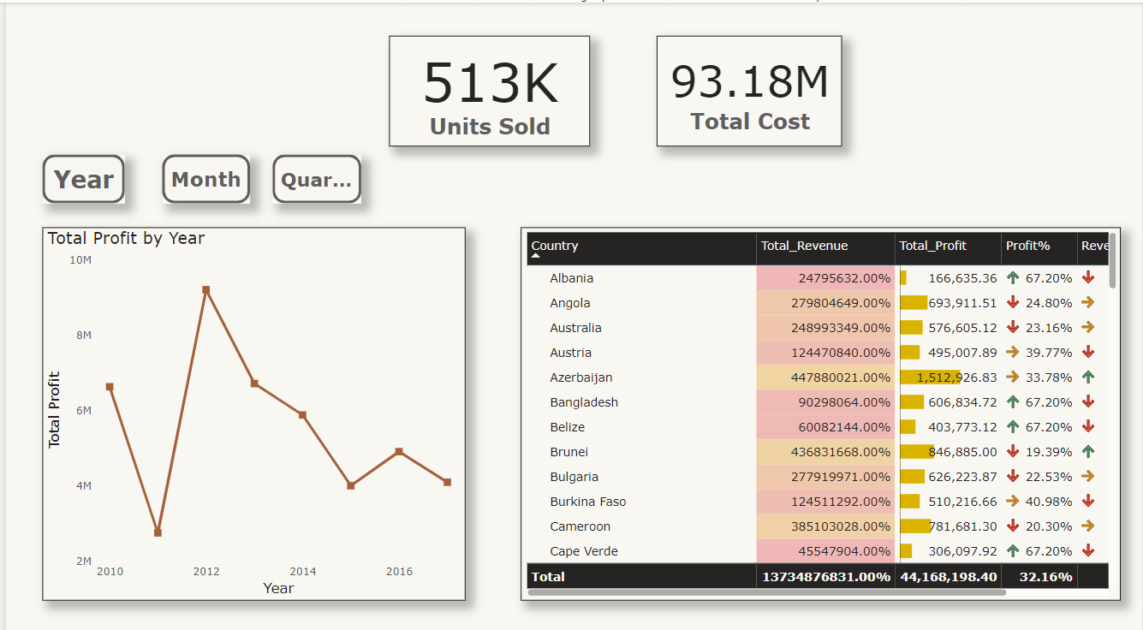
Overall profitability: The company appears to be profitable, with a total profit of 44.17 million on a revenue of 137.35 million. This suggests that the company is able to generate revenue and cover its costs.
Growth: The data shows that the company has experienced significant growth over time. Between 2010 and 2016, total revenue increased from 10 million to 137.35 million. This suggests that the company is expanding its customer base and increasing its market share.
Regional differences: There appear to be significant differences in profitability by region. North America is the most profitable region, followed by Europe and Asia. Africa and South America are the least profitable. This suggests that the company may need to adjust its strategy or pricing in certain regions to improve profitability.
Product mix: The data also shows that there are differences in profitability by product type. Cosmetics is the most profitable item type, followed by household goods and office supplies. Baby food, vegetables, and beverages are the least profitable. This suggests that the company may want to focus on selling more of its more profitable products.

Slide 8
THANK YOU
Smita prajapati
prajapatismita78@gmail.com

